Slide 1
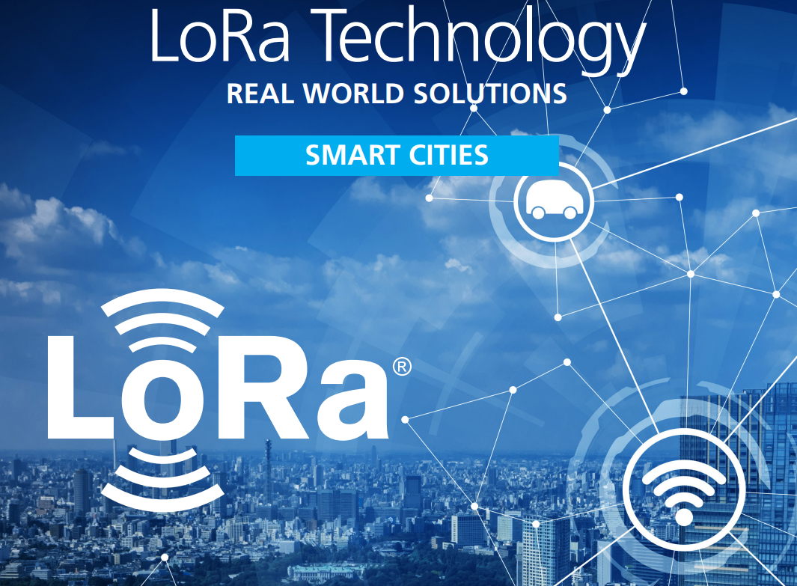
Integrating LoRaWAN
and
Geospatial Technologies
for
Next-Generation Smart Cities
Presented by:
Dr M Brindha
Associate Professor
CSE Department
NIT - Trichy
Dr Sekar C
Assistant Professor
School of Computing
SRMIST - Trichy

Slide 2
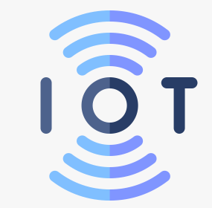
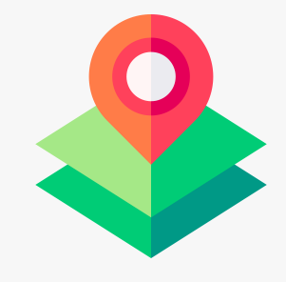

Introduction to Smart Cities
Smart cities aim to improve quality of life, sustainability, and efficiency, addressing urban challenges like congestion, pollution, and resource management.
IoT (Internet of Things): Connects devices across urban environments, collecting real-time data for monitoring and control.
LoRaWAN (Long Range Wide Area Network): Provides low-power, long-distance communication ideal for large-scale IoT networks in cities.
GIS (Geographical Information Systems): Visualizes spatial data, enabling urban planners to make data-driven decisions.
GPS (Global Positioning System): Supports tracking of assets and optimizing public services like transportation.

Slide 3
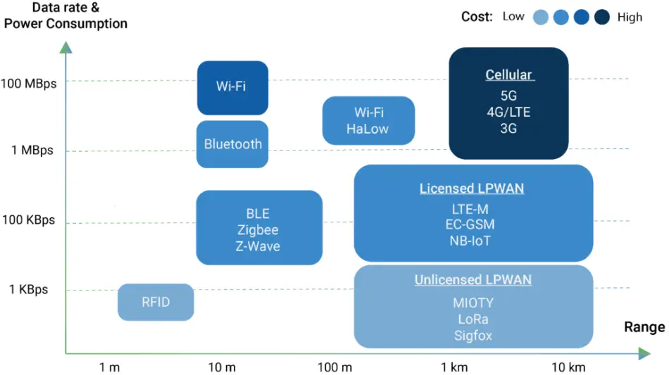
What is LoRaWAN?
LoRaWAN (Long Range Wide Area Network) is a low-power, long-range wireless technology designed for IoT applications.
Derived from Chirp Spread Spectrum (CSS) technology. It encodes information on radio waves using chirp pulses - similar to the way dolphins and bats communicate!
LoRa modulated transmission is robust against disturbances and can be received across Long distances.
Image source : the things network

Slide 4

What is LoRaWAN?
LoRa is ideal for applications that transmit small chunks of data with low bit rates.
Data can be transmitted at a longer range compared to technologies like WiFi, Bluetooth or ZigBee.
These features make LoRa well suited for sensors and actuators that operate in low power mode.
LoRa can be operated on the license free sub-gigahertz bands, for example, 915 MHz, 868 MHz, and 433 MHz.
It also can be operated on 2.4 GHz to achieve higher data rates compared to sub-gigahertz bands, at the cost of range.
These frequencies fall into ISM bands that are reserved internationally for industrial, scientific, and medical purposes

Slide 5
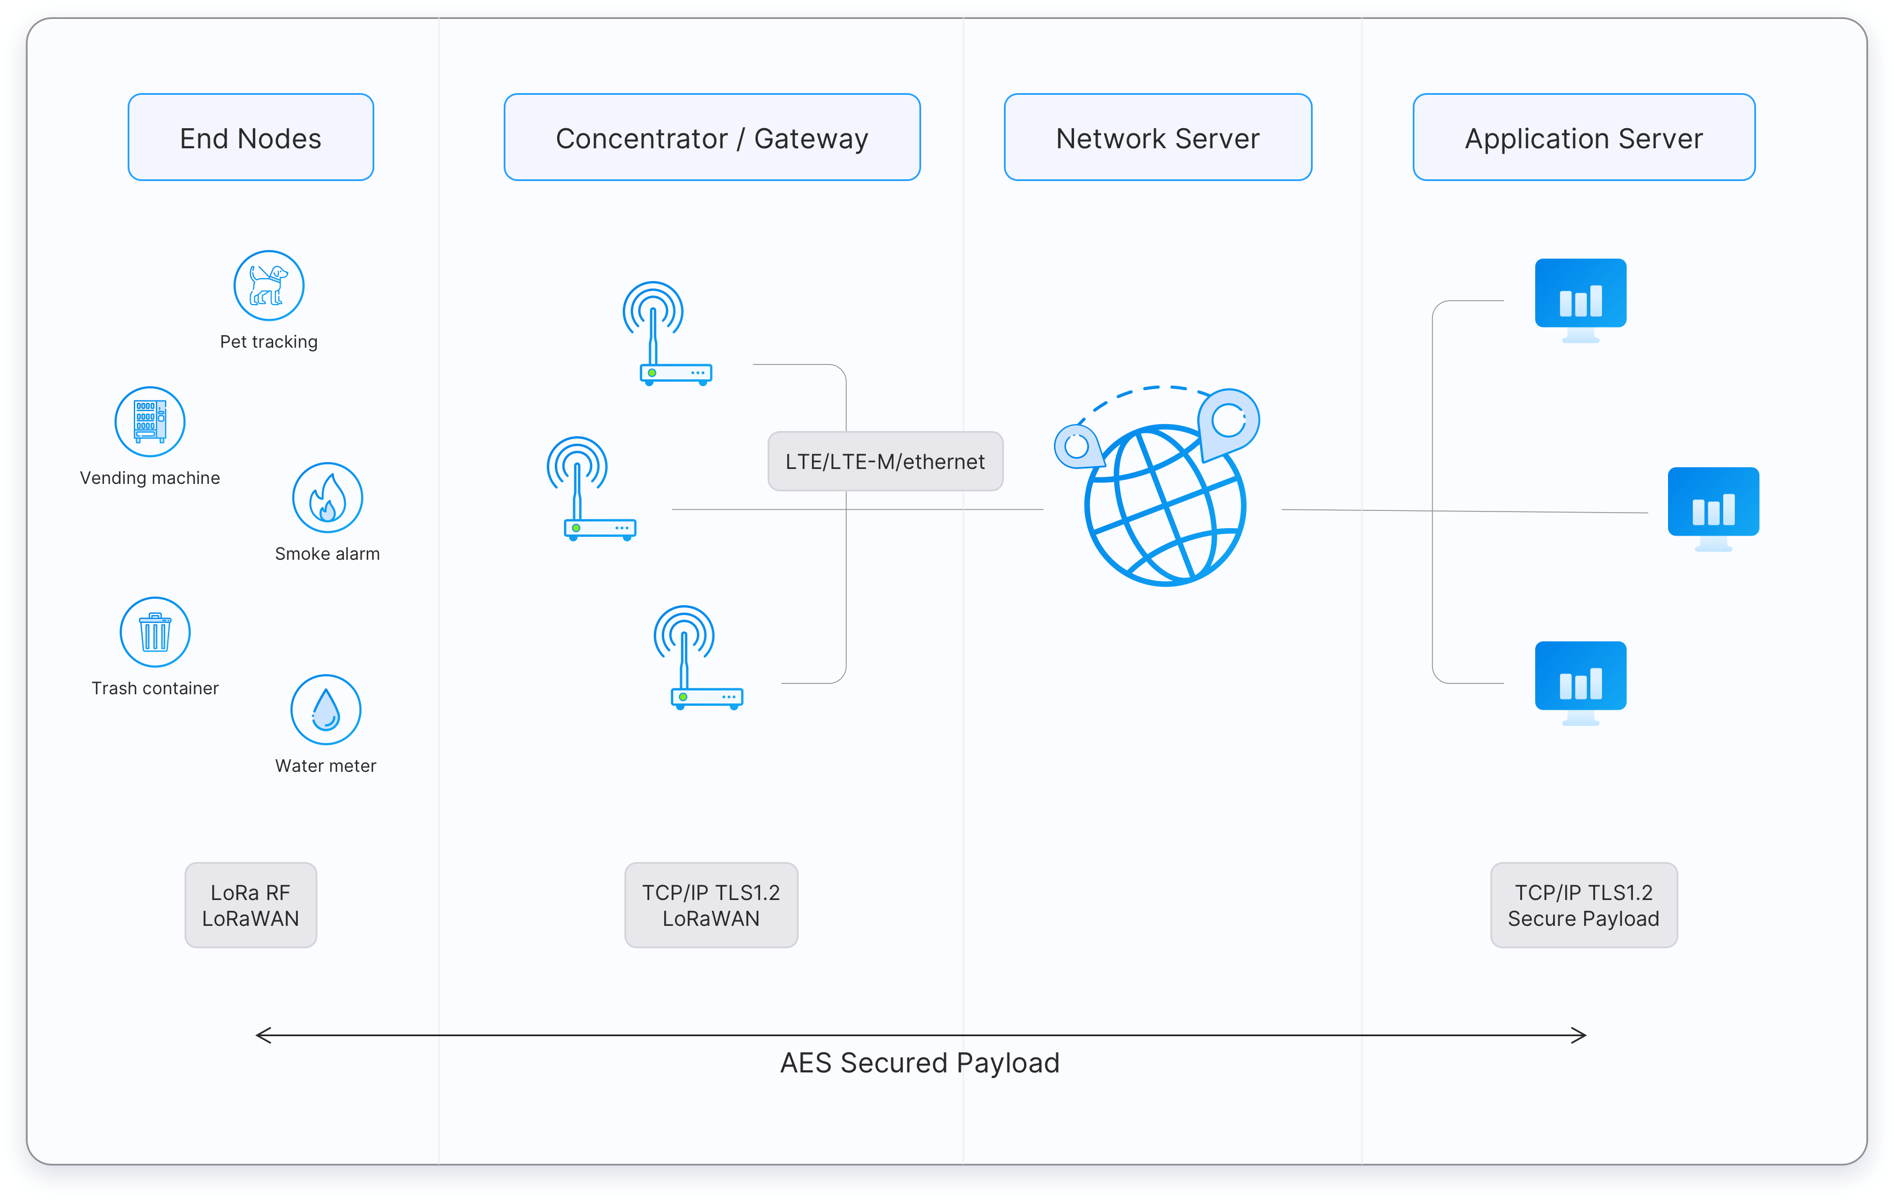
LoRaWAN Architecture
LoRaWAN is a Media Access Control (MAC) layer protocol built on top of LoRa modulation.
Ultra low power - can last up to 10 years on a single coin cell battery.
Long range - can transmit and receive signals over a distance of over 10 kilometers in rural and up to 3 kilometers in dense urban areas.
Deep indoor penetration - deep indoor coverage, and easily cover multi floor buildings.
License free spectrum - You don’t have to pay expensive frequency spectrum license fees to deploy a LoRaWAN network.
Geolocation- can determine the location of end devices using triangulation without the need for GPS. A LoRa end device can be located if at least three gateways pick up its signal.
End-to-end security- secure communication between the end device and the application server using AES-128 encryption.
Firmware updates over the air - can remotely update firmware (applications and the LoRaWAN stack)
Image source : the things network

Slide 6
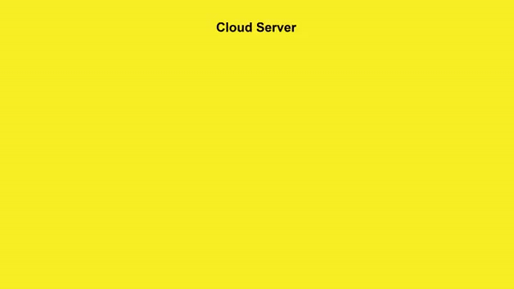
LoRaWAN Architecture
The LoRa Alliance® is an open, non-profit association established in 2015.
LoRaWAN is now an ITU standard
LoRaWAN networks are deployed in a star-of-stars topology.
End Devices - sensors or actuators send LoRa modulated wireless messages to the gateways or receive messages wirelessly back from the gateways. .
Gateways - receive messages from end devices and forward them to the Network Server.
Network Server - a piece of software running on a server that manages the entire network.
Application servers - a piece of software running on a server that is responsible for securely processing application data.

Slide 7
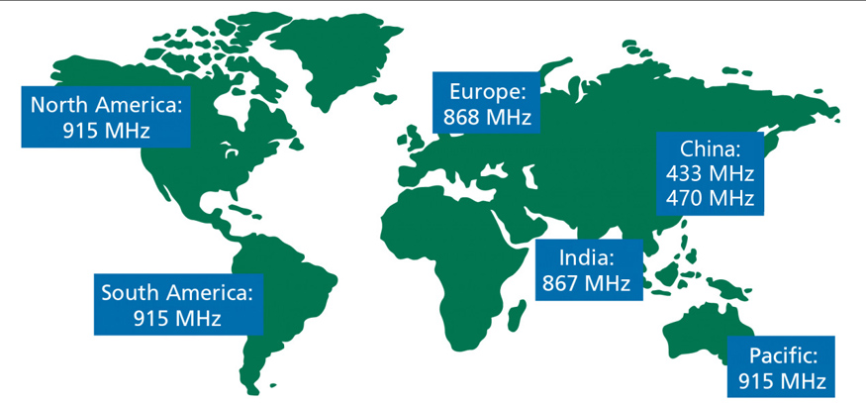
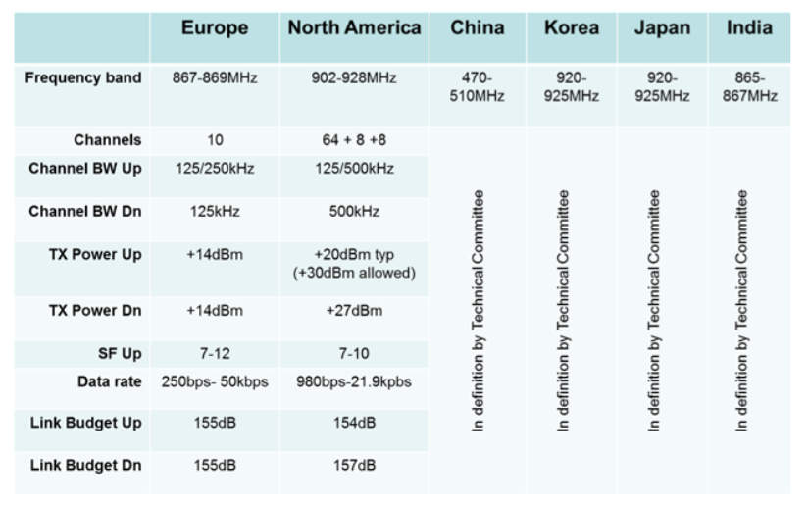
LoRaWAN Frequency
Image source : 3GLTE info

Slide 8
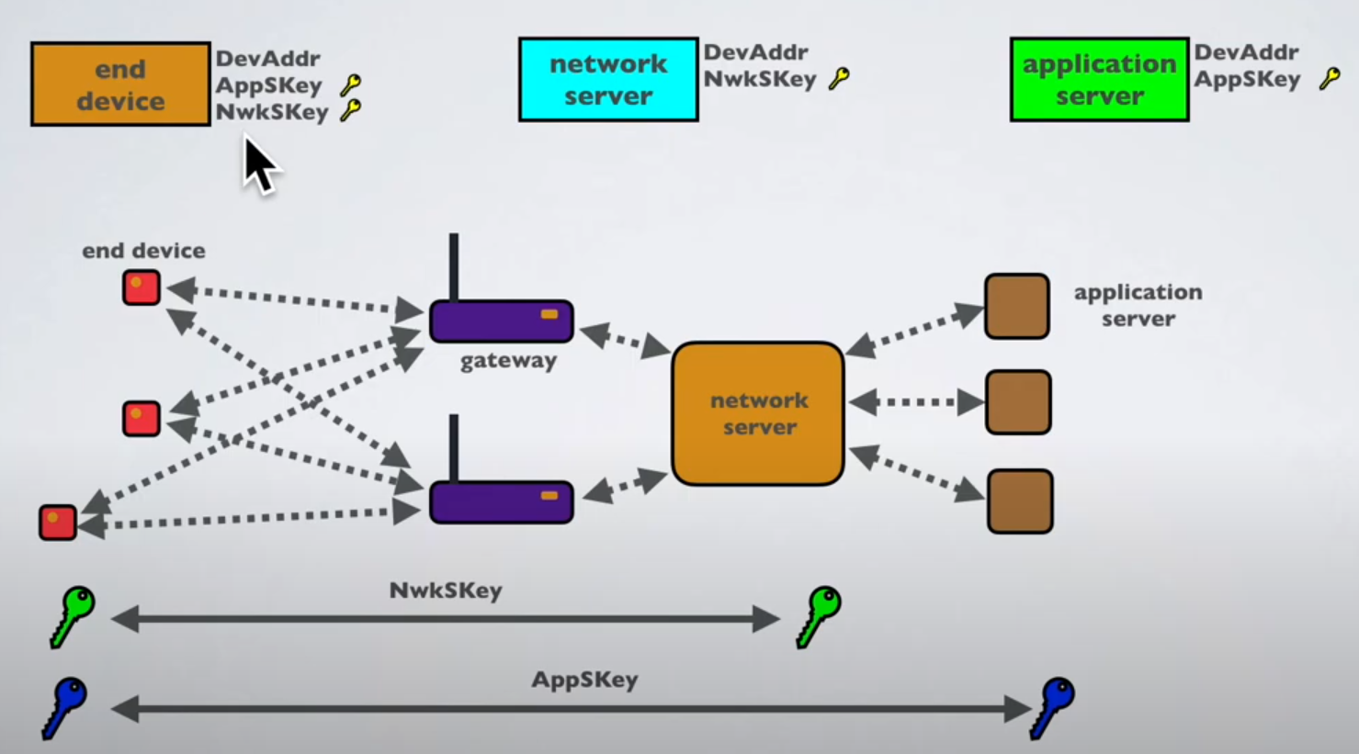
LoRaWAN Security
Security Keys : NwkSKey, AppSKey and AppKey
When a device joins the network (this is called a join or activation), an application session key AppSKey and a network session key NwkSKey are generated. The NwkSKey is shared with the network, while the AppSKey is kept private. These session keys will be used for the duration of the session.
The AppSKey is used for encryption and decryption of the payload.
The application key (AppKey) is only known by the device and by the application.

Slide 9
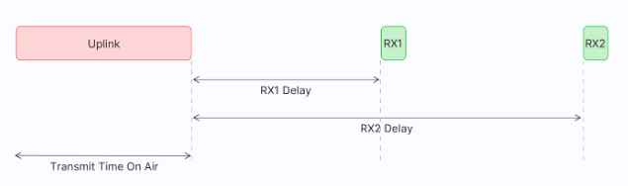
LoRaWAN Device Classes
The LoRaWAN specification defines three device types: Class A, Class B, and Class C
Class A
All LoRaWAN end-devices must support Class A implementation
Class A devices have low power consumption, enabling battery operation.
They spend most time in sleep mode with long intervals between uplinks.
High downlink latency due to needing an uplink before receiving a downlink.
Class A devices can send uplink messages at any time.
After an uplink, two short receive windows open for downlink messages.
RX1 Delay and RX2 Delay occur between the uplink and each receive window.
If no response is received in these windows, the next downlink is scheduled after the next uplink.
The following are some of the use cases for Class A end devices:
Environmental monitoring
Animal tracking
Forest fire detection
Water leakage detection
Smart parking
Asset tracking
Waste management

Slide 10
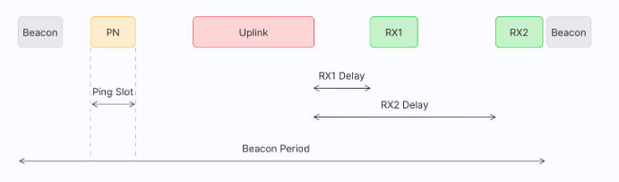
LoRaWAN Device Classes
Class B
Class B Capabilities: Extends Class A by periodically opening receive windows (ping slots) for downlink messages.
Beacons: The network broadcasts time-synchronized beacons, allowing end devices to align their internal clocks for precise timing of downlinks.
Beacon Period: The time interval between two beacons.
Receive Windows: Similar to Class A, RX1 and RX2 open after an uplink.
Latency and Power Consumption:Lower downlink latency than Class A but higher than Class C.
Typically battery-powered; battery life is shorter than Class A due to beacons and ping slots.
Use Cases: Suitable for devices needing medium-criticality downlink timing, such as:
Utility meters (e.g., electricity, water)
Street lights
Class A Compatibility: Can also operate in Class A mode if needed.

Slide 11
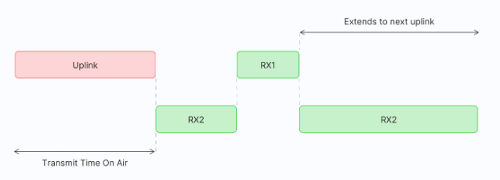
LoRaWAN Device Classes
Class C Capabilities: Extends Class A by keeping receive windows open, except during uplink transmissions.
Receive Windows: Opens RX1 and RX2 after uplink, similar to Class A. RX2 remains open continuously until the next uplink.
Low Latency: Can receive downlink messages at almost any time, providing very low latency.
Power Consumption: Higher power usage due to continuous receive windows; typically mains-powered rather than battery-powered.
Use Cases: Ideal for applications needing immediate actuation, such as:
Utility meters (electric, water)
Street and beacon lights
Alarms
Class A Compatibility: Can also switch to Class A mode when needed.
Class C

Slide 12
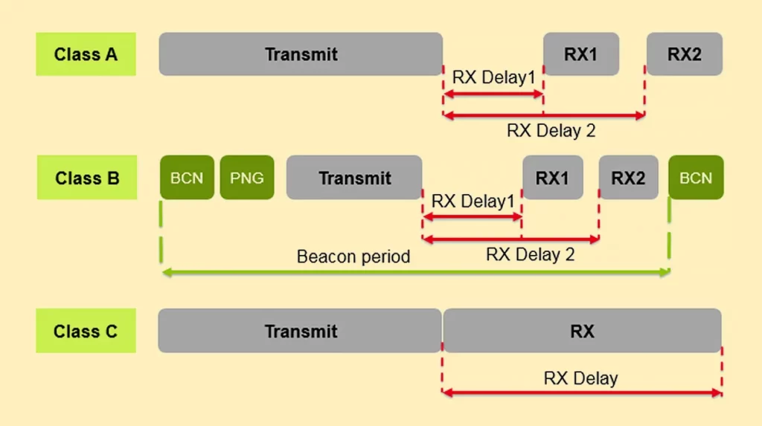
LoRaWAN Device Classes

Slide 13
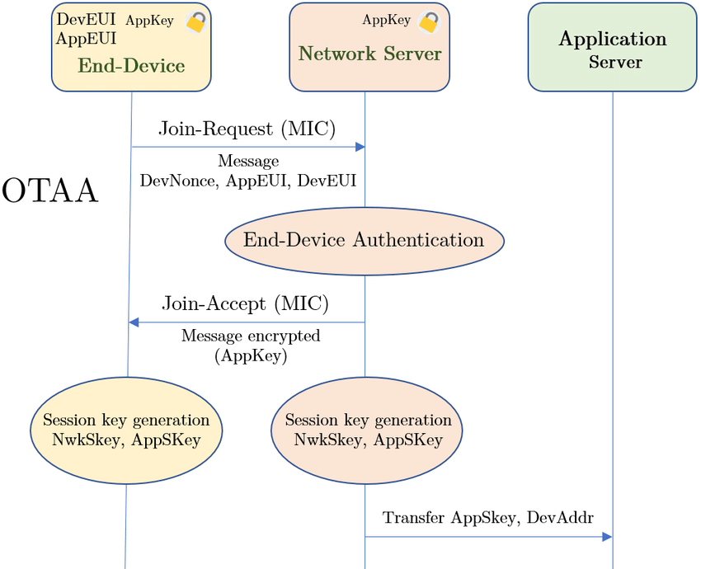
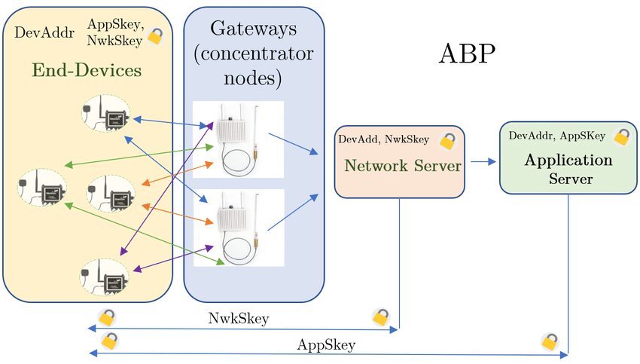
LoRaWAN End Device Activation
Activation Requirement: Every end device must be registered with a network before communication, known as activation.
Activation Methods:
Over-The-Air Activation (OTAA): Most secure and recommended method.Devices perform a join procedure, receiving a dynamic address and negotiating security keys.
Activation By Personalization (ABP): Device address and security keys are hardcoded.Less secure and limits switching between network providers without manual key changes.

Slide 14
LoRaWAN Spreading Factors
LoRa Technology: Based on Chirp Spread Spectrum (CSS), where chirps (symbols) carry data.
Spreading Factor (SF):
Controls chirp rate and data transmission speed.
Lower SF = faster chirps, higher data rate, but reduced range.
Higher SF = slower chirps, lower data rate, but increased range.
Range and Data Rate: Adjusting SF balances range and data rate, impacting transmission distance and processing gain.
Congestion Control: Orthogonal SFs prevent interference on the same frequency, allowing multiple transmissions without conflict.
Spreading Factor (SF) and Bit Rate: Lower SF provides a higher bit rate at fixed bandwidth and coding rate. Example: SF7 has a higher bit rate than SF12.
Bandwidth and Bit Rate: Doubling the bandwidth doubles the bit rate for a fixed SF and coding rate.
Example Bit Rates with SF7 and CR = 1:
125 kHz: 5.5 kbit/s
250 kHz: 10.9 kbit/s
500 kHz: 21.9 kbit/s

Slide 15
LoRaWAN Spreading Factors
LoRa Technology: Based on Chirp Spread Spectrum (CSS), where chirps (symbols) carry data.
Spreading Factor (SF):
Controls chirp rate and data transmission speed.
Lower SF = faster chirps, higher data rate, but reduced range.
Higher SF = slower chirps, lower data rate, but increased range.
Range and Data Rate: Adjusting SF balances range and data rate, impacting transmission distance and processing gain.
Congestion Control: Orthogonal SFs prevent interference on the same frequency, allowing multiple transmissions without conflict.
Spreading Factor (SF) and Bit Rate: Lower SF provides a higher bit rate at fixed bandwidth and coding rate. Example: SF7 has a higher bit rate than SF12.
Bandwidth and Bit Rate: Doubling the bandwidth doubles the bit rate for a fixed SF and coding rate.
Example Bit Rates with SF7 and CR = 1:
125 kHz: 5.5 kbit/s
250 kHz: 10.9 kbit/s
500 kHz: 21.9 kbit/s

Slide 16
LoRaWAN Limitations
Not suitable for:
Real-time data: Limited to small, infrequent packets.
Phone calls: Use GPRS/3G/LTE instead.
Home automation: Use ZigBee or Bluetooth.
High-data tasks: For photos or video, use WiFi.
Uplink Efficiency Tips:
Payload: Minimize size; use binary format (e.g., Cayenne LPP).
Message Interval: Send at several-minute intervals or upon significant changes.
Data Rate: Start with SF7BW125 for low power and airtime; enable Adaptive Data Rate (ADR) if needed.
Downlink Efficiency Tips:
Minimize Downlinks: Avoid if possible, use small payloads.
Data Rate: Downlink rate depends on uplink efficiency.
Avoid Confirmations: Use unconfirmed uplinks if possible to reduce network load and boost reliability.

Slide 17
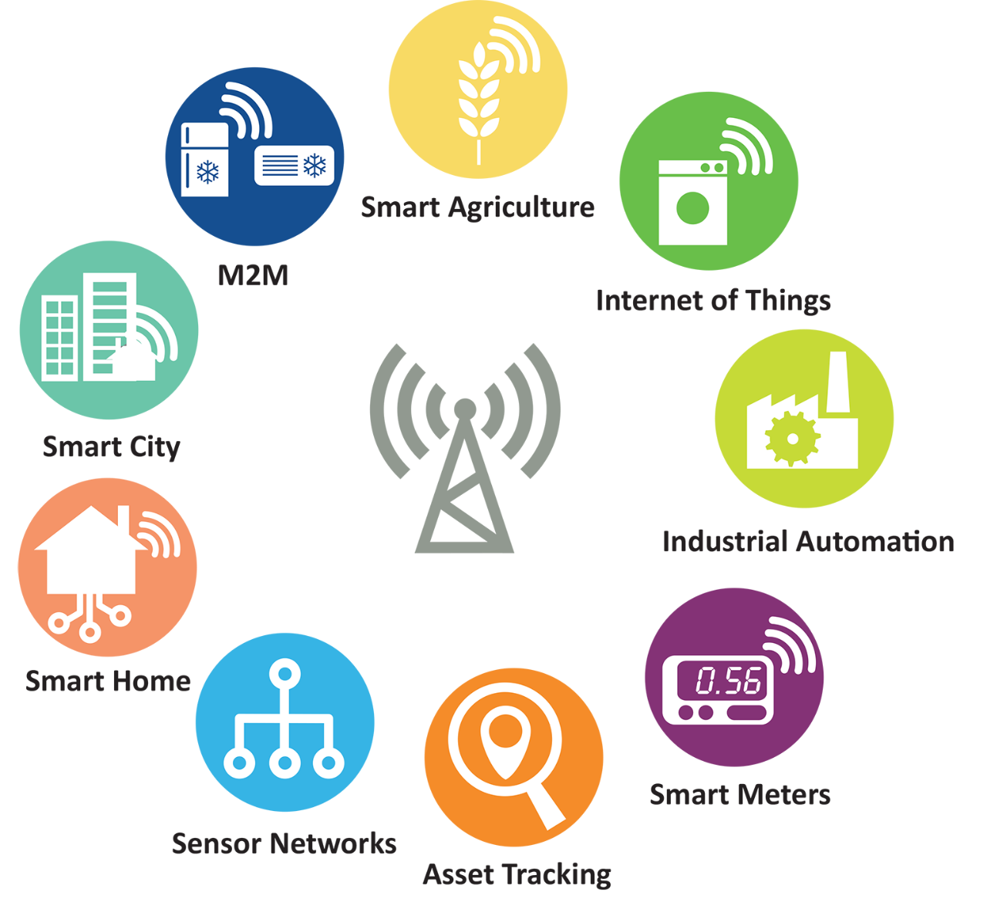

LoRaWAN Usecase
Image source : Semtech

Slide 18
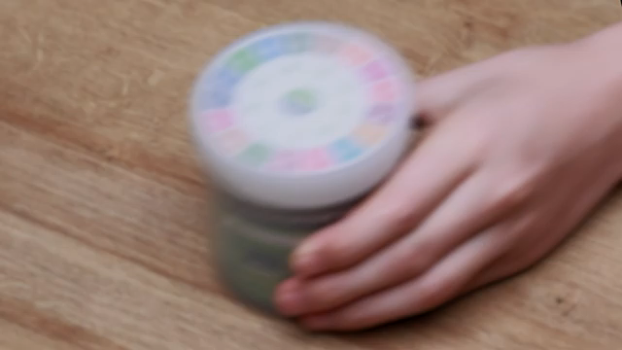
Integration of LoRaWAN and Geospatial Technologies
Real-Time Data Collection with LoRaWAN Sensors
Key Benefits:
Wide Coverage: Ideal for urban environments, covering large areas with fewer gateways.
Low Power Consumption: Extends the battery life of sensors, making them suitable for continuous monitoring.
Real-Time Data: Provides timely data on various urban metrics, such as:
Air quality levels
Noise pollution
Traffic flow
Waste management metrics
Scalability: Easily integrates additional sensors as urban needs grow

Slide 19

Integration of LoRaWAN and Geospatial Technologies
Geospatial Platforms (GIS)
Role of GIS in Urban Management: Geographic Information Systems (GIS) facilitate the analysis, visualization, and management of spatial data.
Visualization of Data:
Map-Based Interfaces: Present data collected from LoRaWAN sensors in an easily interpretable format.
Layered Data Analysis: Users can overlay multiple datasets (e.g., traffic, air quality) to identify patterns and correlations.
Enhanced Decision-Making:
Informed Urban Planning: Leverages real-time data to make proactive decisions regarding infrastructure and services.
Responsive Policy Formulation: Data-driven insights enable local governments to address urban challenges effectively.
Image source : Geospatial World

Slide 20

The Things Industries is a full-service LoRaWAN solutions provider
Build, grow and scale with The Things Stack Cloud
Image source : the things network

Slide 21
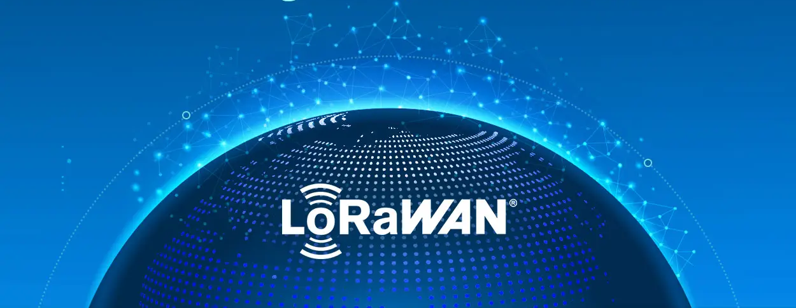
Thank You!!!

